Slide 1
Getting to Know Notebook Server for ArcGIS
George Bochenek
Andrew Chapkowski
GISInc Community Day – 4/28/2019
Notes:
Esri Corporate Template-Dark v3.4
16:9 version – January 29, 2017
For more templates, sample files, and icons, see https://compass.esri.com/resources/presentations/Pages/Main.aspx
To add footer text in Windows
On the Home tab, under Insert, click Text, and then click Header and Footer.
Click the Slide tab, select the Footer check box, and then type the footer text that you want.
Click either Apply or Apply to All.
To add footer text on a Mac
On the View menu, select Header and Footer.
Select the Footer check box and then type the footer text that you want.
Click either Apply or Apply to All.
If footers don't appear on the slides
If footers don't appear on title slides, in the Header and Footer dialog box make sure the Don't show on title slide check box is not selected.
If the footers are missing from other slides, the placeholders for these items might have been removed from specific slide layouts or the slide master.

Slide 2
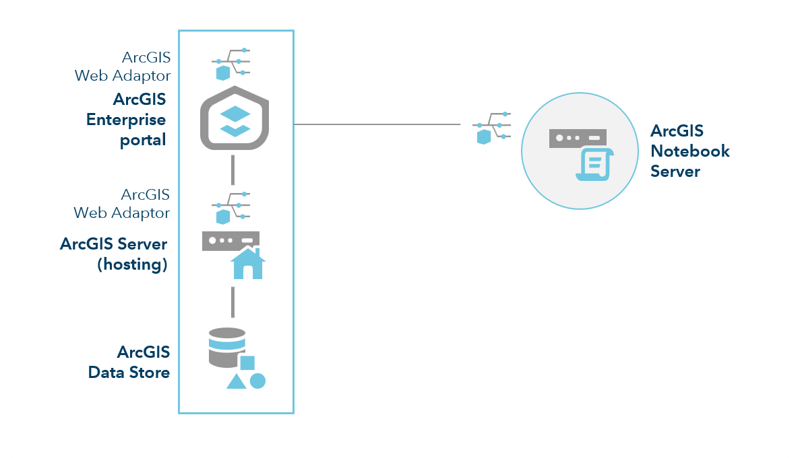

Slide 3



ArcGIS for Enterprise
ArcGIS Python API
Docker

Slide 4

We’re gonna need a bigger server.

Slide 5
Resource Allocation Per User
* Not currently horizontally scalable
Basic Users | Advanced Users
1 CPU Core | 2 CPU Cores
4 GB RAM | 6 GB RAM
ArcGIS Python API Only | Arcpy Included

Slide 6
A Simple Install Guide
…Maybe not that simple
Ensure Enterprise Setup
Install Docker
Configure Docker
Install Notebook Server
Create a Site
Add OS ArcGIS Account to `docker-users`
Run Post-Install
Install Web Adaptor
Federate Your Notebook Site
Assign Roles

Slide 7
Good News: The Documentation is Excellent
Don’t be too proud to use it
https://enterprise.arcgis.com/en/notebook/latest/install/windows/welcome-to-the-arcgis-notebook-server-install-guide.htm

Slide 8
Install not Working?
No Underscores
Windows will let you name a computer with an underscore. Notebook Server will not.
Open Port 11443
Install Hyper-V
Enable WebSockets

Slide 9

Share Organizational Dependencies
No more walking users through conda workflows
Upgrade libraries organization wide
Your tools on any machine (even locked down thin clients)
Auth
Utils
Data

Slide 10
Share Dependencies
https://notebookserver.domain.com:11443/arcgis/admin/
Notebooks > Runtimes
Create a Dockerfile extending an exiting runtime (i.e. add a new `conda install`)
Build a new Docker Image from your Dockerfile
Add the new imageid to your runtimes
https://notebookserver.domain.com:11443/arcgis/admin/

Slide 11
Don’t Share Every Dependency
Every install comes with conda and pip
Users can install their own dependencies that last for the session
No need to create a new Docker image every time a data scientist sees something shiny

Slide 12
Questions?

